Slide 1

How do Organisms
Reproduce?
Male Reproductive System

Slide 2
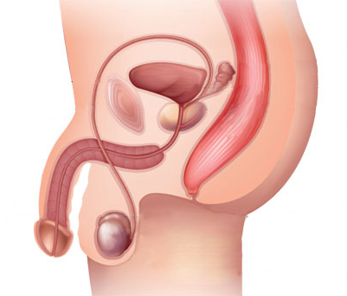
Male Reproductive System
The male reproductive system consists of portions which produce the germ-cells and
other portions that deliver the germ-cells to
the site of fertilisation.

Slide 3
Male Reproductive System
The formation of germ-cells or sperms takes place in the testes.
Testes secret a hormone called as Testosterone.
These are located outside the abdominal cavity in scrotum because sperm formation requires a lower temperature than the normal body temperature.
Testosterone regulates the formation of sperms, and brings about changes in appearance seen in boys at the time of puberty.
Bladder
Seminal vesicles
Scrotum
Testis

Slide 4
Male Reproductive System
The sperms formed are delivered through the vas deferens which unites with a tube coming from the urinary bladder.
The urethra thus forms a common passage for both the sperms and urine.
Penis is the portion of the reproductive system that delivers the sperms to the site of fertilization.
Along the path of the vas deferens, glands like the prostate
and the seminal vesicles
Add their secretions so that the sperms are now in a fluid which makes their transport easier and this fluid also provides nutrition.
Bladder
Seminal vesicles
Prostate gland
Penis
Urethra
Vas deferens
Scrotum
Testis

Slide 5
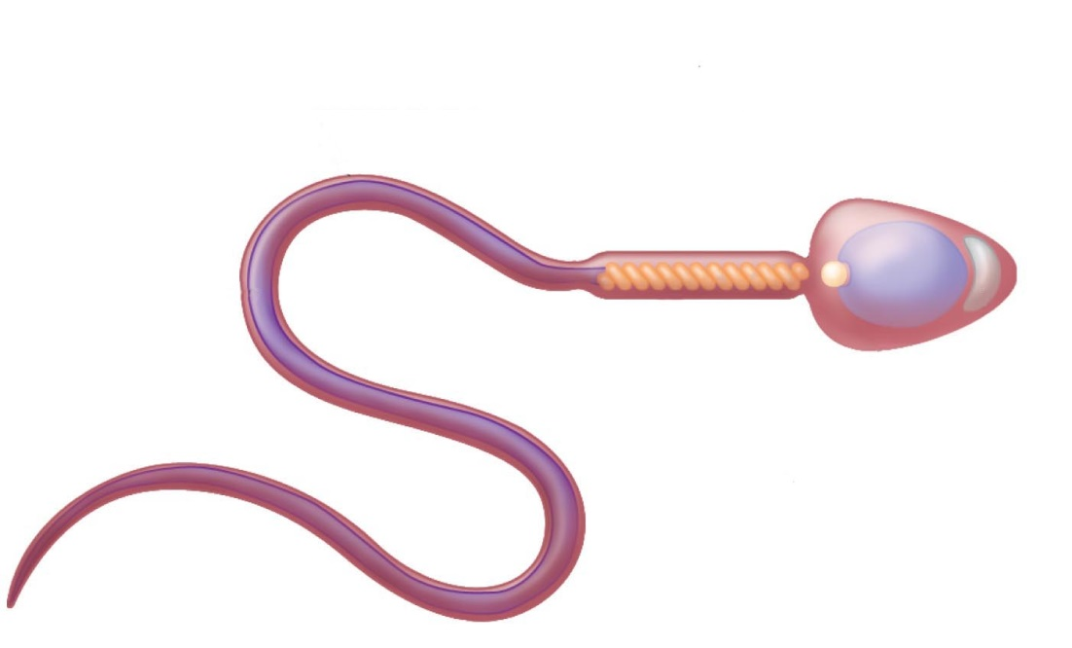
Male Reproductive System
The sperms are tiny bodies that consist of mainly genetic material
that helps them to move towards the female germ-cell.
and a long tail
Female germ-cell
Genetic material
Sperm
Long tail

Slide 6
Thank You

